Slide 1

Kakuma Education Access Analysis
Capstone Project Presentation
Presented by: Geu Mach Nhial
Date: July 18, 2025

Slide 2

Introduction: Addressing Educational Disparities
Our project focuses on understanding school attendance and dropout rates within the Kakuma Refugee Camp. Education is a cornerstone for future opportunities, especially in displacement settings where stability is scarce.
Project Focus
Why It Matters
Key Goals
Understanding school attendance & dropout in Kakuma
Education is vital for long-term opportunities
Analyze school participation patterns
Dropout reduces future prospects
Identify specific dropout trends

Slide 3




Project Objectives: A Data-Driven Approach
To tackle the challenges in Kakuma's education system, our project set out to achieve clear, measurable objectives that would provide actionable insights.
Measure Rates
Analyze Trends
Quantify dropout and attendance rates.
Examine patterns by gender, age, and class level.
Identify Reasons
Provide Recommendations
Pinpoint key causes of school dropout.
Offer data-driven solutions for improvement.

Slide 4

Methodology: Processing Student Data
Our analysis utilized a simulated dataset representing student records from various schools in Kakuma, ensuring the privacy of individuals while providing realistic insights.
Dataset Overview
Simulated student records from Kakuma schools.
Data Processing Steps
Cleaned missing/null values (using bfill() and ffill()).
Created new columns: Class Group, Age Group.
Applied filters: gender, school, dropout status.
Standardized inconsistent class levels into "Lower," "Middle," "Upper," and "Secondary."
Tools Utilized
Python for data manipulation and analysis.
Power BI for interactive visualizations.

Slide 5
Key Performance Indicators (KPIs)
Our analysis of the simulated data revealed critical insights into student enrollment and retention dynamics within the Kakuma Refugee Camp.
1000
828
172
17.20%
Total Students
Active Students
Dropout Students
Dropout Rate
Overall student population recorded.
Students currently attending school.
Students who have left school.
Percentage of students who dropped out.
82.80%
Retention Rate
Percentage of students retained in school.

Slide 6
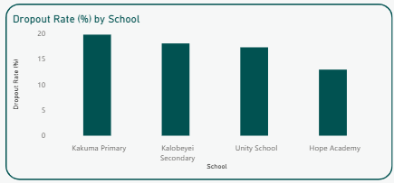
Key Insights #1: Dropouts per School
Analyzing dropout numbers across different schools provides a crucial overview of where retention efforts are most needed.
Kakuma Primary experiences the highest number of student dropouts, indicating significant challenges in student retention. In contrast, Hope Academy demonstrates strong retention with the lowest dropout figures.

Slide 7
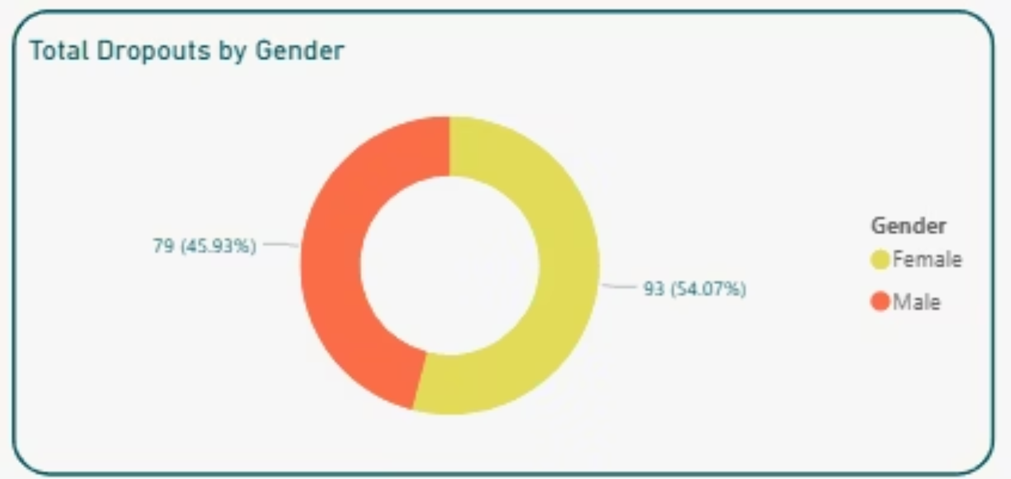
Key Insights #2: Total Dropouts by Gender
Gender-disaggregated data reveals a significant disparity in dropout rates, highlighting specific vulnerabilities that need to be addressed.
Dropout rates are significantly higher among female students compared to male students.
This gender disparity underscores urgent social and economic factors disproportionately affecting girls' access to continuous education.

Slide 8
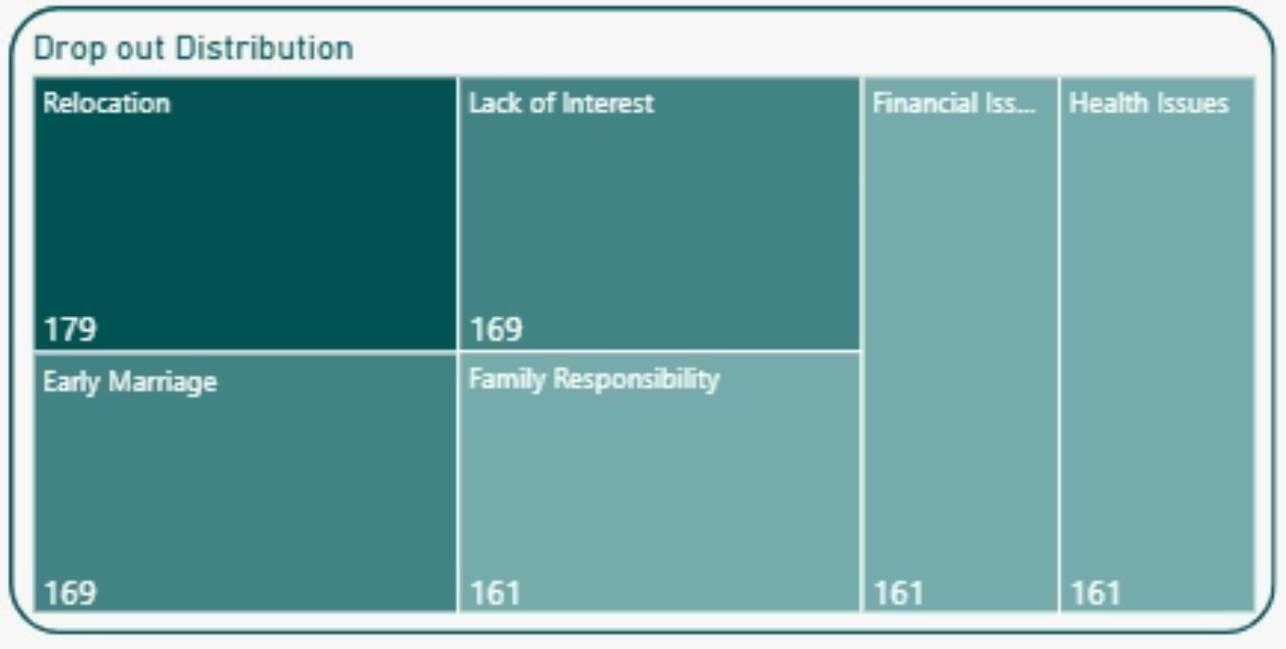
Key Insights #3: Top Dropout Reasons
Understanding the root causes of student dropout is essential for developing targeted interventions.
Relocation: The Primary Driver
Student relocation is the leading dropout reason, pointing to high mobility and instability within the refugee population.
Social & Motivational Challenges
Early marriage and lack of interest are significant secondary causes, disproportionately affecting female and older students.
Economic & Health Obstacles
Financial issues, family responsibilities, and health problems also contribute, reflecting systemic barriers to educational continuity.

Slide 9
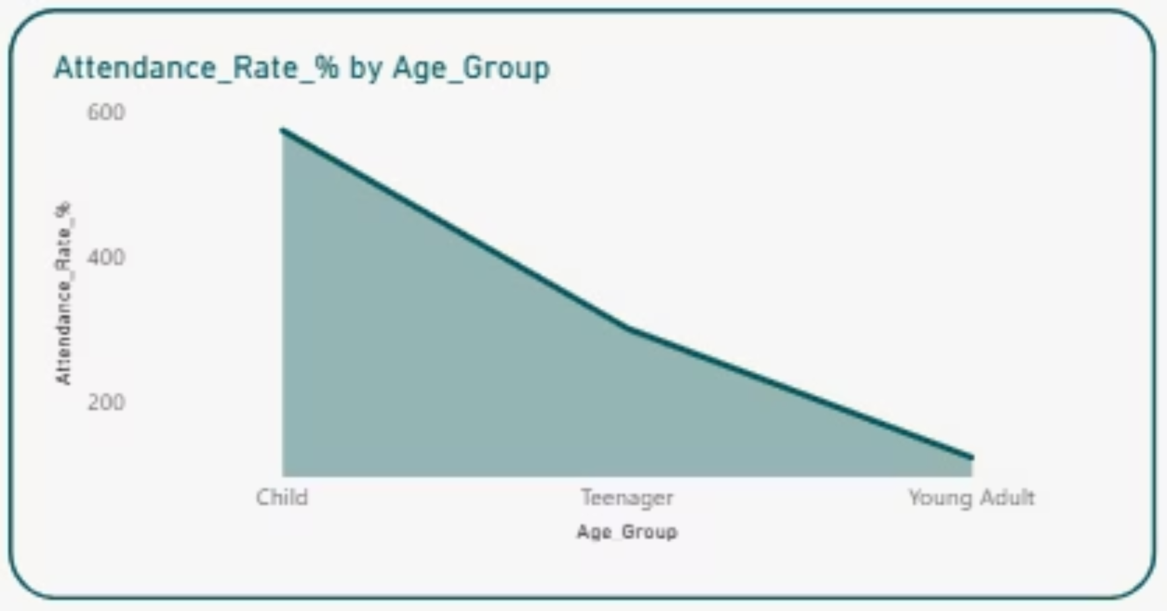
Key Insights #4: Attendance Rate by Age Group
Analyzing attendance rates by age group reveals varied patterns, highlighting specific needs for different developmental stages.
Children (younger age groups) exhibit the highest dropout rates, suggesting early vulnerabilities. In contrast, young adults show the lowest dropout rates, indicating stronger retention in later stages of education.

Slide 10
Project Insights & Recommendations
Our analysis underscores key challenges and opportunities for improving education access in Kakuma Refugee Camp.
Project Insights
Recommendations
Attendance is inconsistent across the student population.
Implement community awareness programs promoting education.
Dropout is often tied to socioeconomic and cultural factors.
Provide targeted financial support or incentives for vulnerable students.
Female students and younger children are disproportionately affected by dropout.
Engage families through outreach to emphasize the value of schooling.
Improve school accessibility and integrate comprehensive health services.

